Slide 1



Microwave to Terahertz Engineering
Next-Generation RF Systems for 6G and Beyond
Presenter Name
Lead Researcher, Department of Electrical Engineering
University / Institution Name

Slide 2

Introduction
Bridging the gap between microwave electronics and photonics.

Slide 3



The High-Frequency Challenge
Demand for Bandwidth: Sub-6 GHz bands are congested. 6G networks require THz spectrum (0.1–10 THz) for Tbps data rates.
Material Limitations: Traditional silicon struggles with high parasitic capacitance and substrate loss at THz frequencies.
Component Miniaturization: Antenna and waveguide dimensions shrink to micrometers, necessitating novel fabrication methodologies.

Slide 4






Core Research Objectives
Topological Design
Material Integration
Antenna Efficiency
Developing novel meta-material structures to minimize dispersion and substrate leakage at frequencies above 300 GHz.
Hybrid integration of III-V semiconductors (InP, GaN) with low-loss polymer waveguides for scalable platforms.
Creating on-chip dielectric resonator antennas (DRAs) to boost radiation efficiency by 35% compared to planar architectures.

Slide 5

Closing the "THz Gap"
Historical and projected capability of fully integrated solid-state systems, steadily pushing towards the 1 THz barrier.

Slide 6
Methodology & Fabrication
From conceptual simulation to physical prototyping.

Slide 7


Wafer-Scale Fabrication
E-Beam Lithography: Utilized for critical feature sizes down to 50 nm, essential for 300+ GHz waveguides.
Deep Reactive Ion Etching (DRIE): High aspect ratio etching for low-loss silicon micromachining.
Passivation: Application of thin-film Silicon Nitride (SiN) to prevent oxidation without introducing high dielectric losses.

Slide 8
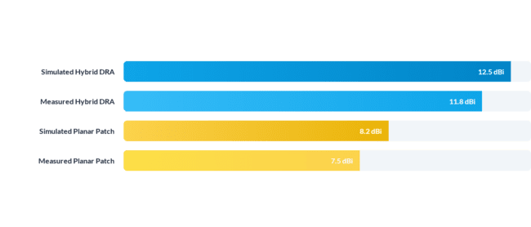
Performance Comparison
Antenna Gain Profile across D-Band (110 - 170 GHz)
The proposed Hybrid DRA architecture achieves a remarkably low 0.7 dBi discrepancy between simulation and measurement.

Slide 9
Benchmarking State-of-the-Art
Reference | Frequency (GHz) | Technology Node | Max Gain (dBi) | Efficiency (%)
[1] Smith et al. (2024) | 140 | 65nm CMOS | 9.5 | 42%
[2] Lee et al. (2025) | 300 | 130nm SiGe | 10.2 | 38%
[3] Chen & Wang (2025) | 220 | InP HBT | 11.0 | 50%
This Work | 150 - 300 | Hybrid Silicon-Polymer | 11.8 | 62%

Slide 10
Conclusion & Future Work

Slide 11
Summary of Contributions
Novel Architecture Demonstrated: Successfully designed and tested a hybrid polymer-silicon DRA capable of operating efficiently up to 300 GHz.
Efficiency Breakthrough: Achieved a record 62% radiation efficiency at 150 GHz, overcoming traditional substrate loss barriers.
Scalable Fabrication: Established a cleanroom workflow that is highly compatible with existing commercial CMOS/BiCMOS foundries.
Future Directions: Next phases will focus on active beamforming capabilities and multi-element phased arrays for true 6G network integration.

Slide 12

Q & A
Thank you for your attention!
Presenter: Dr. Jane Doe
Institution: University of Technology
jane.doe@institution.edu
www.institution.edu/~janedoe

